Slide 1

Module 8
Methods and Unity Classes

Slide 2
Content (slot 2)
Putting It All Together
Exercise 31: The Bouncer
Common Mistakes

Slide 3
8.9 Putting It All Together
The problem description: Design and implement a class to represent a hand of cards. You also need to provide the standard hand operations for the class.
Understand the Problem
Create Hand objects
access the cards in the hand
add a card to a hand
remove a card from the hand
check whether or not the hand is empty

Slide 4
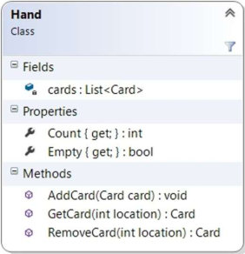
8.9 Putting It All Together
Design a Solution
Hand Class Diagram

Slide 5
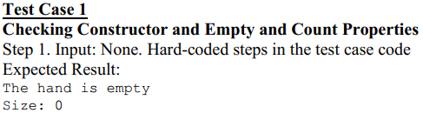
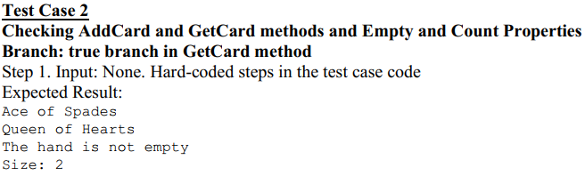
8.9 Putting It All Together
Write Test Cases

Slide 6
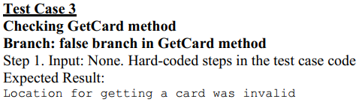
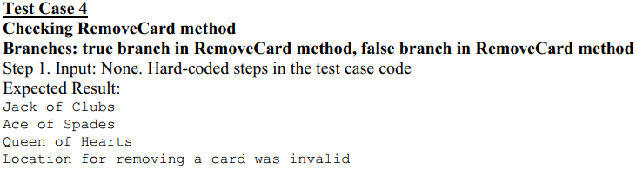
8.9 Putting It All Together
Write Test Cases

Slide 7



8.9 Putting It All Together
Write the Code
add the single field to the class
write the constructor
The Count property
the Empty property

Slide 8

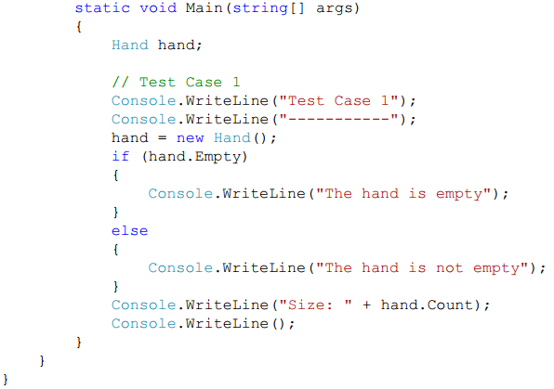
8.9 Putting It All Together
Test the Code
add driver code for Test Case 1 to the Program class

Slide 9


8.9 Putting It All Together
Test the Code
Test Case 1 Results
Write the Code, Part 2
the AddCard method

Slide 10
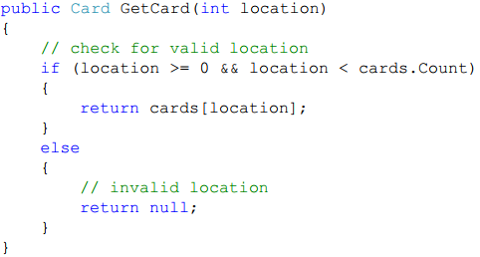
8.9 Putting It All Together
Write the Code, Part 2
the GetCard method

Slide 11
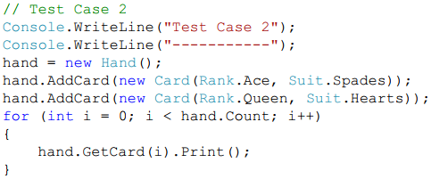

8.9 Putting It All Together
Test the Code, Part 2
the code for Test Case 2

Slide 12
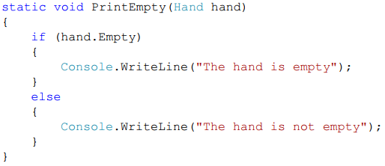
8.9 Putting It All Together
Test the Code, Part 2
PrintEmpty method in the Program class:

Slide 13
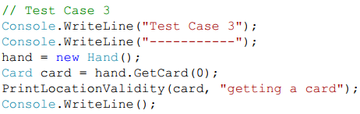
8.9 Putting It All Together
Test the Code, Part 2
Driver code the Test Case 3 is:

Slide 14
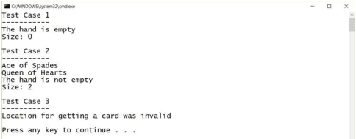
8.9 Putting It All Together
Test the Code, Part 2
Test Cases 1-3 Results

Slide 15
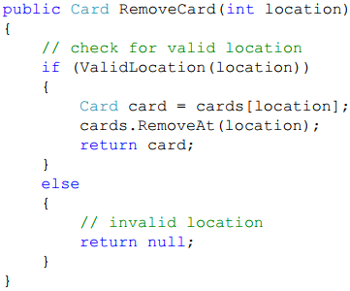
8.9 Putting It All Together
Write the Code, Part 3
The RemoveCard method

Slide 16

8.9 Putting It All Together
Write the Code, Part 3
the ValidLocation method

Slide 17
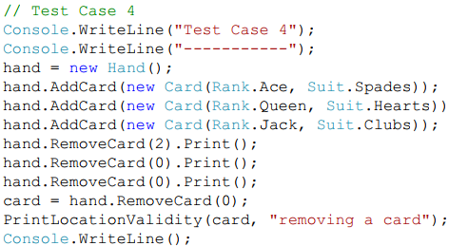
8.9 Putting It All Together
Test the Code, Part 3
the code for Test Case 4

Slide 18
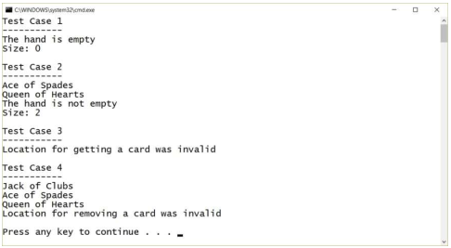
8.9 Putting It All Together
Test the Code, Part 3
All Test Case Results

Slide 19
Exercise 31: The Bouncer
View in LMS

Slide 20
8.10 Common Mistakes
Not Including an Argument for Each Parameter
Trying to call the method with too few or too many arguments results in a compilation error.
Mismatched Data Types Between Arguments and Parameters
A type mismatch between the arguments and parameters results in a compilation error.
Mixing up the Order of Arguments and Parameters
While the problem in this example would be pretty easy to discover and correct, it's a lot harder to identify this kind of problem with methods that do calculations.
Method Never Runs
If you've written a method that never runs when you execute your program, you probably forgot to add the code that calls the method.

Slide 21
Summary
The Method Header
The Method Body
Parameters
Passing Objects as Parameters

